Slide 1

Harry
http://projects.spring.io/spring-cloud/
PPT模板下载：www.1ppt.com/moban/ 行业PPT模板：www.1ppt.com/hangye/
节日PPT模板：www.1ppt.com/jieri/ PPT素材下载：www.1ppt.com/sucai/
PPT背景图片：www.1ppt.com/beijing/ PPT图表下载：www.1ppt.com/tubiao/
优秀PPT下载：www.1ppt.com/xiazai/ PPT教程： www.1ppt.com/powerpoint/
Word教程： www.1ppt.com/word/ Excel教程：www.1ppt.com/excel/
资料下载：www.1ppt.com/ziliao/ PPT课件下载：www.1ppt.com/kejian/
范文下载：www.1ppt.com/fanwen/ 试卷下载：www.1ppt.com/shiti/
教案下载：www.1ppt.com/jiaoan/ PPT论坛：www.1ppt.cn

Slide 2


Microservice 未来 -- Service Mesh
服务网格（Service Mesh）这个术语通常用于描述构成这些应用程序的微服务网络以及应用之间的交互。随着规模和复杂性的增长，服务网格越来越难以理解和管理。它的需求包括服务发现、负载均衡、故障恢复、指标收集和监控以及通常更加复杂的运维需求，例如 A/B 测试、金丝雀发布、限流、访问控制和端到端认证等。
Istio 提供了一个完整的解决方案，通过为整个服务网格提供行为洞察和操作控制来满足微服务应用程序的多样化需求。
PPT模板下载：www.1ppt.com/moban/ 行业PPT模板：www.1ppt.com/hangye/
节日PPT模板：www.1ppt.com/jieri/ PPT素材下载：www.1ppt.com/sucai/
PPT背景图片：www.1ppt.com/beijing/ PPT图表下载：www.1ppt.com/tubiao/
优秀PPT下载：www.1ppt.com/xiazai/ PPT教程： www.1ppt.com/powerpoint/
Word教程： www.1ppt.com/word/ Excel教程：www.1ppt.com/excel/
资料下载：www.1ppt.com/ziliao/ PPT课件下载：www.1ppt.com/kejian/
范文下载：www.1ppt.com/fanwen/ 试卷下载：www.1ppt.com/shiti/
教案下载：www.1ppt.com/jiaoan/ PPT论坛：www.1ppt.cn

Slide 3
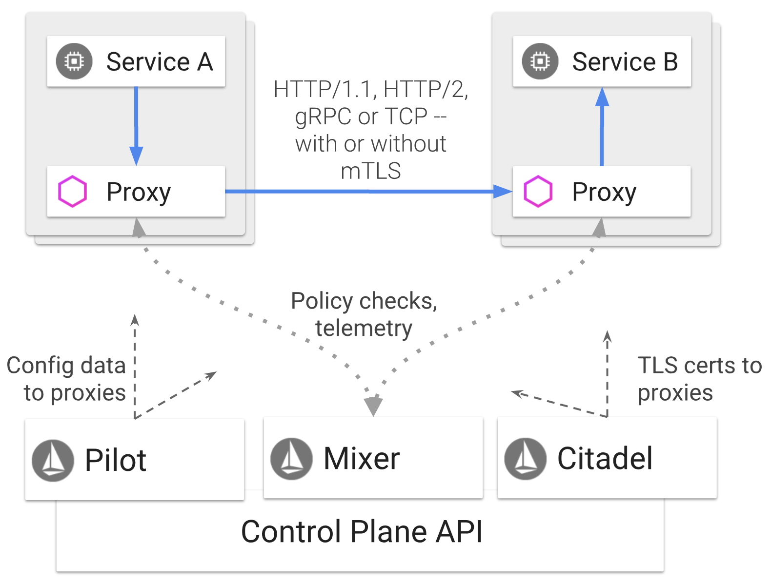
SOFA Mesh VS Istio
PPT模板下载：www.1ppt.com/moban/ 行业PPT模板：www.1ppt.com/hangye/
节日PPT模板：www.1ppt.com/jieri/ PPT素材下载：www.1ppt.com/sucai/
PPT背景图片：www.1ppt.com/beijing/ PPT图表下载：www.1ppt.com/tubiao/
优秀PPT下载：www.1ppt.com/xiazai/ PPT教程： www.1ppt.com/powerpoint/
Word教程： www.1ppt.com/word/ Excel教程：www.1ppt.com/excel/
资料下载：www.1ppt.com/ziliao/ PPT课件下载：www.1ppt.com/kejian/
范文下载：www.1ppt.com/fanwen/ 试卷下载：www.1ppt.com/shiti/
教案下载：www.1ppt.com/jiaoan/ PPT论坛：www.1ppt.cn

Slide 4
Spring Cloud Common Core Components
PPT模板下载：www.1ppt.com/moban/ 行业PPT模板：www.1ppt.com/hangye/
节日PPT模板：www.1ppt.com/jieri/ PPT素材下载：www.1ppt.com/sucai/
PPT背景图片：www.1ppt.com/beijing/ PPT图表下载：www.1ppt.com/tubiao/
优秀PPT下载：www.1ppt.com/xiazai/ PPT教程： www.1ppt.com/powerpoint/
Word教程： www.1ppt.com/word/ Excel教程：www.1ppt.com/excel/
资料下载：www.1ppt.com/ziliao/ PPT课件下载：www.1ppt.com/kejian/
范文下载：www.1ppt.com/fanwen/ 试卷下载：www.1ppt.com/shiti/
教案下载：www.1ppt.com/jiaoan/ PPT论坛：www.1ppt.cn

Slide 5
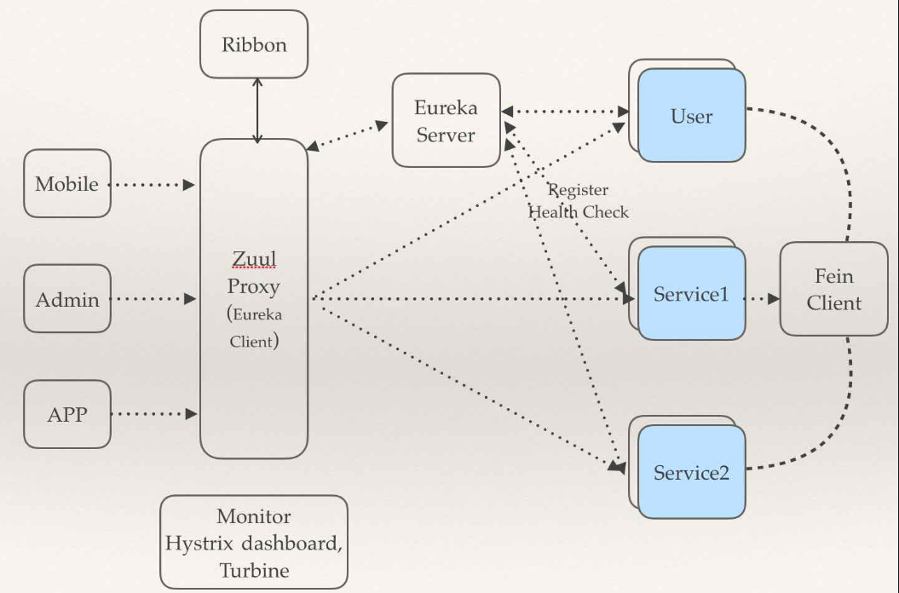
Spring Cloud Components Relations
PPT模板下载：www.1ppt.com/moban/ 行业PPT模板：www.1ppt.com/hangye/
节日PPT模板：www.1ppt.com/jieri/ PPT素材下载：www.1ppt.com/sucai/
PPT背景图片：www.1ppt.com/beijing/ PPT图表下载：www.1ppt.com/tubiao/
优秀PPT下载：www.1ppt.com/xiazai/ PPT教程： www.1ppt.com/powerpoint/
Word教程： www.1ppt.com/word/ Excel教程：www.1ppt.com/excel/
资料下载：www.1ppt.com/ziliao/ PPT课件下载：www.1ppt.com/kejian/
范文下载：www.1ppt.com/fanwen/ 试卷下载：www.1ppt.com/shiti/
教案下载：www.1ppt.com/jiaoan/ PPT论坛：www.1ppt.cn

Slide 6

Spring Cloud Eureka
https://github.com/Netflix/eureka
云端服务发现，一个基于 REST 的服务，用于定位服务，以实现云端中间层服务发现和故障转移。
PPT模板下载：www.1ppt.com/moban/ 行业PPT模板：www.1ppt.com/hangye/
节日PPT模板：www.1ppt.com/jieri/ PPT素材下载：www.1ppt.com/sucai/
PPT背景图片：www.1ppt.com/beijing/ PPT图表下载：www.1ppt.com/tubiao/
优秀PPT下载：www.1ppt.com/xiazai/ PPT教程： www.1ppt.com/powerpoint/
Word教程： www.1ppt.com/word/ Excel教程：www.1ppt.com/excel/
资料下载：www.1ppt.com/ziliao/ PPT课件下载：www.1ppt.com/kejian/
范文下载：www.1ppt.com/fanwen/ 试卷下载：www.1ppt.com/shiti/
教案下载：www.1ppt.com/jiaoan/ PPT论坛：www.1ppt.cn

Slide 7
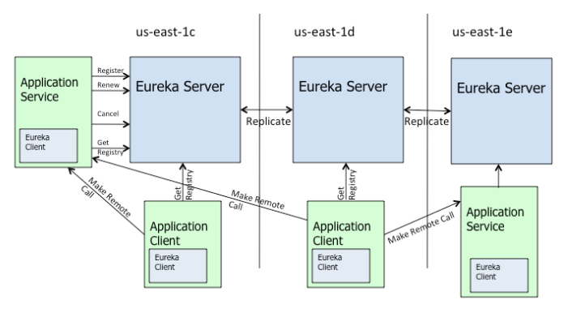
Spring Cloud Eureka
PPT模板下载：www.1ppt.com/moban/ 行业PPT模板：www.1ppt.com/hangye/
节日PPT模板：www.1ppt.com/jieri/ PPT素材下载：www.1ppt.com/sucai/
PPT背景图片：www.1ppt.com/beijing/ PPT图表下载：www.1ppt.com/tubiao/
优秀PPT下载：www.1ppt.com/xiazai/ PPT教程： www.1ppt.com/powerpoint/
Word教程： www.1ppt.com/word/ Excel教程：www.1ppt.com/excel/
资料下载：www.1ppt.com/ziliao/ PPT课件下载：www.1ppt.com/kejian/
范文下载：www.1ppt.com/fanwen/ 试卷下载：www.1ppt.com/shiti/
教案下载：www.1ppt.com/jiaoan/ PPT论坛：www.1ppt.cn

Slide 8
Spring Cloud Eureka VS Alibaba Nacos
Nacos 是阿里巴巴的新开源项目，其核心定位是 “一个更易于帮助构建云原生应用的动态服务发现、配置和服务管理平台”。
PPT模板下载：www.1ppt.com/moban/ 行业PPT模板：www.1ppt.com/hangye/
节日PPT模板：www.1ppt.com/jieri/ PPT素材下载：www.1ppt.com/sucai/
PPT背景图片：www.1ppt.com/beijing/ PPT图表下载：www.1ppt.com/tubiao/
优秀PPT下载：www.1ppt.com/xiazai/ PPT教程： www.1ppt.com/powerpoint/
Word教程： www.1ppt.com/word/ Excel教程：www.1ppt.com/excel/
资料下载：www.1ppt.com/ziliao/ PPT课件下载：www.1ppt.com/kejian/
范文下载：www.1ppt.com/fanwen/ 试卷下载：www.1ppt.com/shiti/
教案下载：www.1ppt.com/jiaoan/ PPT论坛：www.1ppt.cn

Slide 9
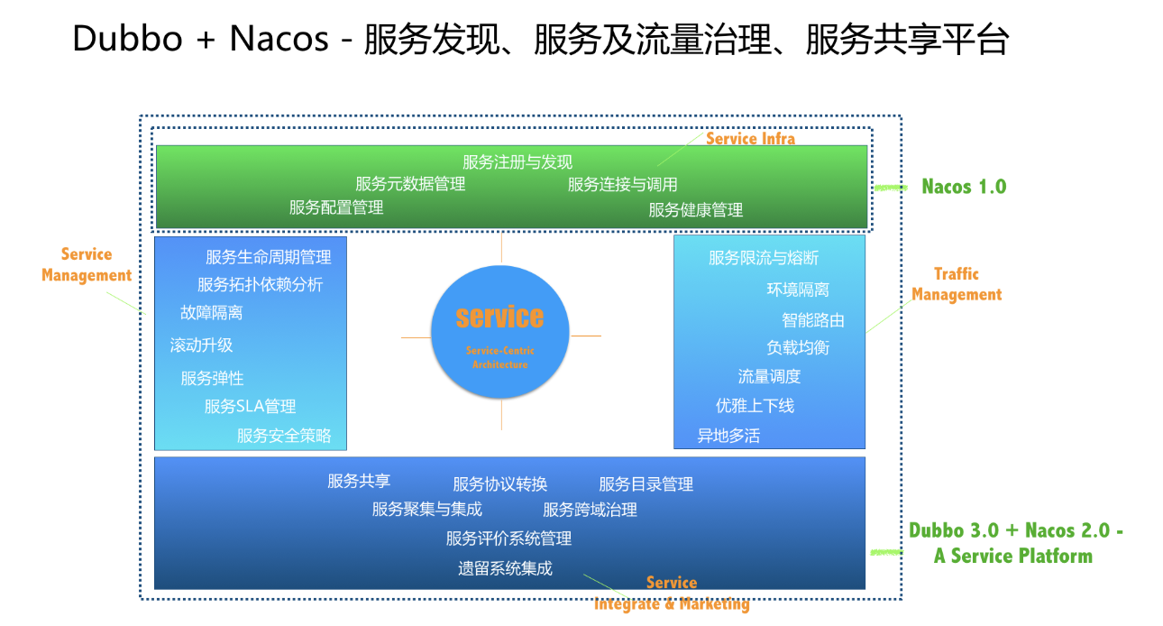
Alibaba Nacos
Service Discovery and Service Health Check
Dynamic Configuration Management
Dynamic DNS Service
Service and MetaData Management
PPT模板下载：www.1ppt.com/moban/ 行业PPT模板：www.1ppt.com/hangye/
节日PPT模板：www.1ppt.com/jieri/ PPT素材下载：www.1ppt.com/sucai/
PPT背景图片：www.1ppt.com/beijing/ PPT图表下载：www.1ppt.com/tubiao/
优秀PPT下载：www.1ppt.com/xiazai/ PPT教程： www.1ppt.com/powerpoint/
Word教程： www.1ppt.com/word/ Excel教程：www.1ppt.com/excel/
资料下载：www.1ppt.com/ziliao/ PPT课件下载：www.1ppt.com/kejian/
范文下载：www.1ppt.com/fanwen/ 试卷下载：www.1ppt.com/shiti/
教案下载：www.1ppt.com/jiaoan/ PPT论坛：www.1ppt.cn

Slide 10
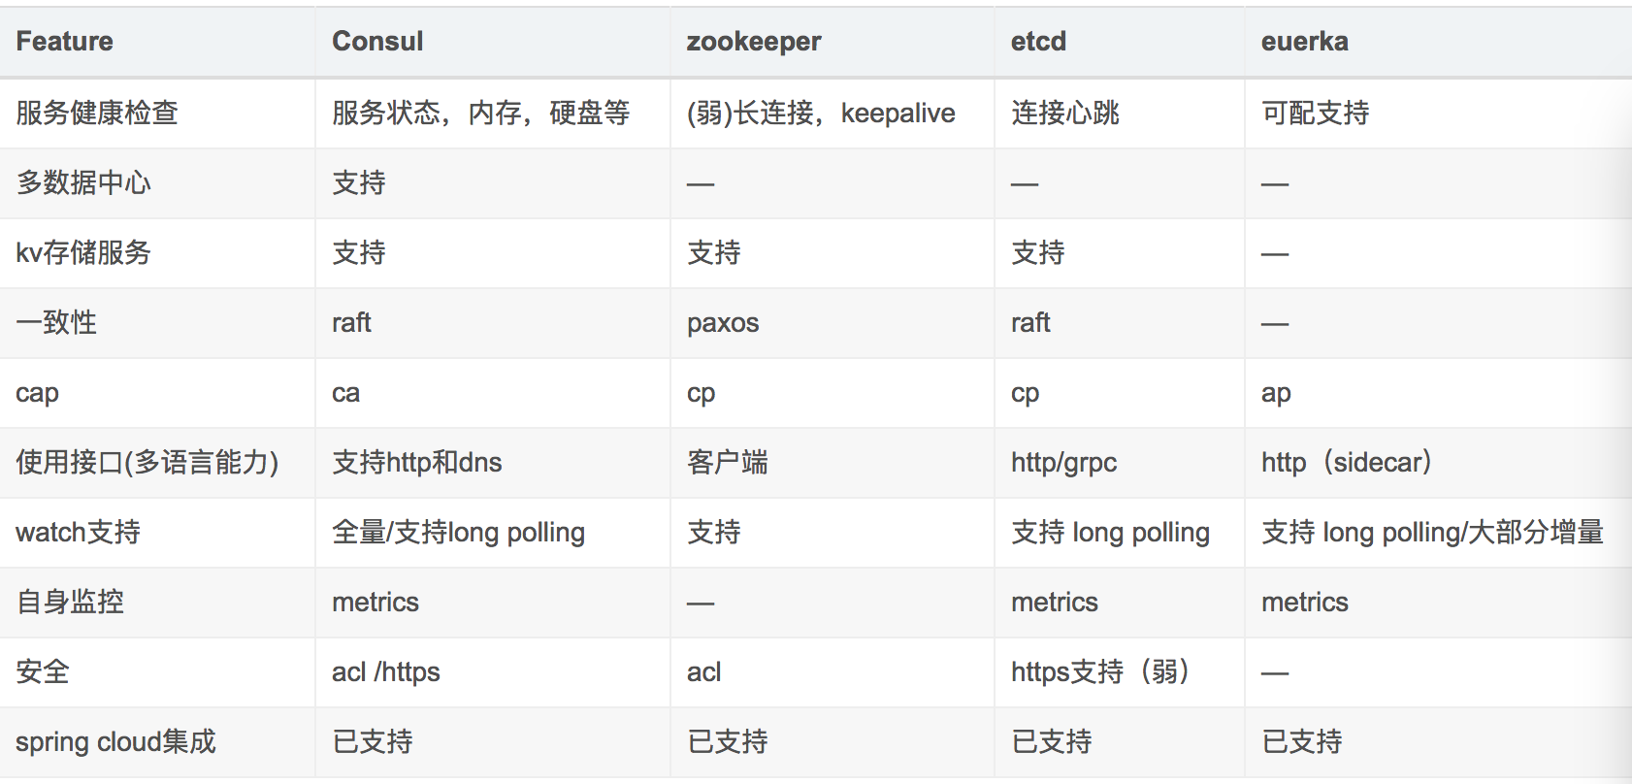
Eureka vs Consul vs Zookeeper vs Etcd
PPT模板下载：www.1ppt.com/moban/ 行业PPT模板：www.1ppt.com/hangye/
节日PPT模板：www.1ppt.com/jieri/ PPT素材下载：www.1ppt.com/sucai/
PPT背景图片：www.1ppt.com/beijing/ PPT图表下载：www.1ppt.com/tubiao/
优秀PPT下载：www.1ppt.com/xiazai/ PPT教程： www.1ppt.com/powerpoint/
Word教程： www.1ppt.com/word/ Excel教程：www.1ppt.com/excel/
资料下载：www.1ppt.com/ziliao/ PPT课件下载：www.1ppt.com/kejian/
范文下载：www.1ppt.com/fanwen/ 试卷下载：www.1ppt.com/shiti/
教案下载：www.1ppt.com/jiaoan/ PPT论坛：www.1ppt.cn

Slide 11

Spring Cloud Ribbon
https://github.com/Netflix/ribbon
提供客户端的负载均衡，有多种负载均衡策略可供选择，可配合服务发现和断路器使用
PPT模板下载：www.1ppt.com/moban/ 行业PPT模板：www.1ppt.com/hangye/
节日PPT模板：www.1ppt.com/jieri/ PPT素材下载：www.1ppt.com/sucai/
PPT背景图片：www.1ppt.com/beijing/ PPT图表下载：www.1ppt.com/tubiao/
优秀PPT下载：www.1ppt.com/xiazai/ PPT教程： www.1ppt.com/powerpoint/
Word教程： www.1ppt.com/word/ Excel教程：www.1ppt.com/excel/
资料下载：www.1ppt.com/ziliao/ PPT课件下载：www.1ppt.com/kejian/
范文下载：www.1ppt.com/fanwen/ 试卷下载：www.1ppt.com/shiti/
教案下载：www.1ppt.com/jiaoan/ PPT论坛：www.1ppt.cn

Slide 12

Spring Cloud Hystrix
https://github.com/Netflix/hystrix
熔断器，容错管理工具，旨在通过熔断机制控制服务和第三方库的节点,从而对延迟和故障提供更强大的容错能力
PPT模板下载：www.1ppt.com/moban/ 行业PPT模板：www.1ppt.com/hangye/
节日PPT模板：www.1ppt.com/jieri/ PPT素材下载：www.1ppt.com/sucai/
PPT背景图片：www.1ppt.com/beijing/ PPT图表下载：www.1ppt.com/tubiao/
优秀PPT下载：www.1ppt.com/xiazai/ PPT教程： www.1ppt.com/powerpoint/
Word教程： www.1ppt.com/word/ Excel教程：www.1ppt.com/excel/
资料下载：www.1ppt.com/ziliao/ PPT课件下载：www.1ppt.com/kejian/
范文下载：www.1ppt.com/fanwen/ 试卷下载：www.1ppt.com/shiti/
教案下载：www.1ppt.com/jiaoan/ PPT论坛：www.1ppt.cn

Slide 13

Spring Cloud Hystrix VS Alibaba Sentinel
https://github.com/alibaba/Sentinel
A lightweight flow-control library providing high-available protection and monitoring
PPT模板下载：www.1ppt.com/moban/ 行业PPT模板：www.1ppt.com/hangye/
节日PPT模板：www.1ppt.com/jieri/ PPT素材下载：www.1ppt.com/sucai/
PPT背景图片：www.1ppt.com/beijing/ PPT图表下载：www.1ppt.com/tubiao/
优秀PPT下载：www.1ppt.com/xiazai/ PPT教程： www.1ppt.com/powerpoint/
Word教程： www.1ppt.com/word/ Excel教程：www.1ppt.com/excel/
资料下载：www.1ppt.com/ziliao/ PPT课件下载：www.1ppt.com/kejian/
范文下载：www.1ppt.com/fanwen/ 试卷下载：www.1ppt.com/shiti/
教案下载：www.1ppt.com/jiaoan/ PPT论坛：www.1ppt.cn

Slide 14

Spring Cloud Feign
https://github.com/OpenFeign/feign
Feign是一种声明式、模板化的HTTP客户端
PPT模板下载：www.1ppt.com/moban/ 行业PPT模板：www.1ppt.com/hangye/
节日PPT模板：www.1ppt.com/jieri/ PPT素材下载：www.1ppt.com/sucai/
PPT背景图片：www.1ppt.com/beijing/ PPT图表下载：www.1ppt.com/tubiao/
优秀PPT下载：www.1ppt.com/xiazai/ PPT教程： www.1ppt.com/powerpoint/
Word教程： www.1ppt.com/word/ Excel教程：www.1ppt.com/excel/
资料下载：www.1ppt.com/ziliao/ PPT课件下载：www.1ppt.com/kejian/
范文下载：www.1ppt.com/fanwen/ 试卷下载：www.1ppt.com/shiti/
教案下载：www.1ppt.com/jiaoan/ PPT论坛：www.1ppt.cn

Slide 15

Spring Cloud Zuul
https://github.com/Netflix/zuul
Zuul 是在云平台上提供动态路由,监控,弹性,安全等边缘服务的框架。Zuul 相当于是设备和 Netflix 流应用的 Web 网站后端所有请求的前门
PPT模板下载：www.1ppt.com/moban/ 行业PPT模板：www.1ppt.com/hangye/
节日PPT模板：www.1ppt.com/jieri/ PPT素材下载：www.1ppt.com/sucai/
PPT背景图片：www.1ppt.com/beijing/ PPT图表下载：www.1ppt.com/tubiao/
优秀PPT下载：www.1ppt.com/xiazai/ PPT教程： www.1ppt.com/powerpoint/
Word教程： www.1ppt.com/word/ Excel教程：www.1ppt.com/excel/
资料下载：www.1ppt.com/ziliao/ PPT课件下载：www.1ppt.com/kejian/
范文下载：www.1ppt.com/fanwen/ 试卷下载：www.1ppt.com/shiti/
教案下载：www.1ppt.com/jiaoan/ PPT论坛：www.1ppt.cn

Slide 16
Spring Cloud Zuul
Request routing
Request filtering
Dynamic routing
Filter
Exception handling
Retry
Authentication
Security
Pressure measurement
Business compose
PPT模板下载：www.1ppt.com/moban/ 行业PPT模板：www.1ppt.com/hangye/
节日PPT模板：www.1ppt.com/jieri/ PPT素材下载：www.1ppt.com/sucai/
PPT背景图片：www.1ppt.com/beijing/ PPT图表下载：www.1ppt.com/tubiao/
优秀PPT下载：www.1ppt.com/xiazai/ PPT教程： www.1ppt.com/powerpoint/
Word教程： www.1ppt.com/word/ Excel教程：www.1ppt.com/excel/
资料下载：www.1ppt.com/ziliao/ PPT课件下载：www.1ppt.com/kejian/
范文下载：www.1ppt.com/fanwen/ 试卷下载：www.1ppt.com/shiti/
教案下载：www.1ppt.com/jiaoan/ PPT论坛：www.1ppt.cn

Slide 17
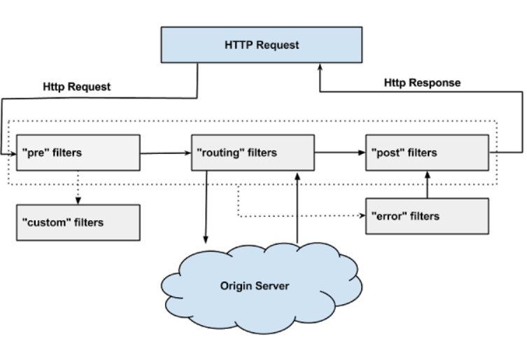
Spring Cloud Zuul-ZuulFilter
PPT模板下载：www.1ppt.com/moban/ 行业PPT模板：www.1ppt.com/hangye/
节日PPT模板：www.1ppt.com/jieri/ PPT素材下载：www.1ppt.com/sucai/
PPT背景图片：www.1ppt.com/beijing/ PPT图表下载：www.1ppt.com/tubiao/
优秀PPT下载：www.1ppt.com/xiazai/ PPT教程： www.1ppt.com/powerpoint/
Word教程： www.1ppt.com/word/ Excel教程：www.1ppt.com/excel/
资料下载：www.1ppt.com/ziliao/ PPT课件下载：www.1ppt.com/kejian/
范文下载：www.1ppt.com/fanwen/ 试卷下载：www.1ppt.com/shiti/
教案下载：www.1ppt.com/jiaoan/ PPT论坛：www.1ppt.cn

Slide 18

Spring Cloud Config
https://github.com/spring-cloud/spring-cloud-config/
配置管理工具包，让你可以把配置放到远程服务器，集中化管理集群配置，目前支持本地存储、Git以及Subversion
PPT模板下载：www.1ppt.com/moban/ 行业PPT模板：www.1ppt.com/hangye/
节日PPT模板：www.1ppt.com/jieri/ PPT素材下载：www.1ppt.com/sucai/
PPT背景图片：www.1ppt.com/beijing/ PPT图表下载：www.1ppt.com/tubiao/
优秀PPT下载：www.1ppt.com/xiazai/ PPT教程： www.1ppt.com/powerpoint/
Word教程： www.1ppt.com/word/ Excel教程：www.1ppt.com/excel/
资料下载：www.1ppt.com/ziliao/ PPT课件下载：www.1ppt.com/kejian/
范文下载：www.1ppt.com/fanwen/ 试卷下载：www.1ppt.com/shiti/
教案下载：www.1ppt.com/jiaoan/ PPT论坛：www.1ppt.cn

Slide 19
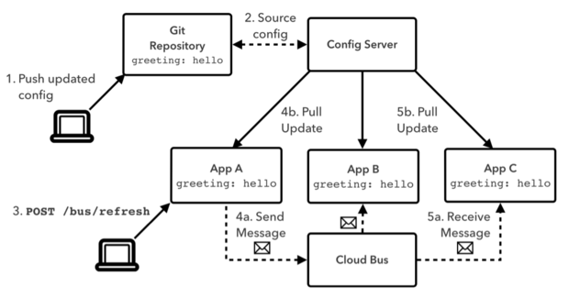
PPT模板下载：www.1ppt.com/moban/ 行业PPT模板：www.1ppt.com/hangye/
节日PPT模板：www.1ppt.com/jieri/ PPT素材下载：www.1ppt.com/sucai/
PPT背景图片：www.1ppt.com/beijing/ PPT图表下载：www.1ppt.com/tubiao/
优秀PPT下载：www.1ppt.com/xiazai/ PPT教程： www.1ppt.com/powerpoint/
Word教程： www.1ppt.com/word/ Excel教程：www.1ppt.com/excel/
资料下载：www.1ppt.com/ziliao/ PPT课件下载：www.1ppt.com/kejian/
范文下载：www.1ppt.com/fanwen/ 试卷下载：www.1ppt.com/shiti/
教案下载：www.1ppt.com/jiaoan/ PPT论坛：www.1ppt.cn

Slide 20

Spring Cloud Bus
https://github.com/spring-cloud/spring-cloud-bus
事件、消息总线，用于在集群（例如，配置变化事件）中传播状态变化，可与Spring Cloud Config联合实现热部署
PPT模板下载：www.1ppt.com/moban/ 行业PPT模板：www.1ppt.com/hangye/
节日PPT模板：www.1ppt.com/jieri/ PPT素材下载：www.1ppt.com/sucai/
PPT背景图片：www.1ppt.com/beijing/ PPT图表下载：www.1ppt.com/tubiao/
优秀PPT下载：www.1ppt.com/xiazai/ PPT教程： www.1ppt.com/powerpoint/
Word教程： www.1ppt.com/word/ Excel教程：www.1ppt.com/excel/
资料下载：www.1ppt.com/ziliao/ PPT课件下载：www.1ppt.com/kejian/
范文下载：www.1ppt.com/fanwen/ 试卷下载：www.1ppt.com/shiti/
教案下载：www.1ppt.com/jiaoan/ PPT论坛：www.1ppt.cn

Slide 21

Spring Cloud Stream
https://github.com/spring-cloud/spring-cloud-stream
数据流操作开发包，封装了与Redis,Rabbit、Kafka等发送接收消
PPT模板下载：www.1ppt.com/moban/ 行业PPT模板：www.1ppt.com/hangye/
节日PPT模板：www.1ppt.com/jieri/ PPT素材下载：www.1ppt.com/sucai/
PPT背景图片：www.1ppt.com/beijing/ PPT图表下载：www.1ppt.com/tubiao/
优秀PPT下载：www.1ppt.com/xiazai/ PPT教程： www.1ppt.com/powerpoint/
Word教程： www.1ppt.com/word/ Excel教程：www.1ppt.com/excel/
资料下载：www.1ppt.com/ziliao/ PPT课件下载：www.1ppt.com/kejian/
范文下载：www.1ppt.com/fanwen/ 试卷下载：www.1ppt.com/shiti/
教案下载：www.1ppt.com/jiaoan/ PPT论坛：www.1ppt.cn

Slide 22
Spring Cloud Stream - Core concept
Binder
Persistent Publish-Subscribe Support
Consumer Groups
Partitioning Support
PPT模板下载：www.1ppt.com/moban/ 行业PPT模板：www.1ppt.com/hangye/
节日PPT模板：www.1ppt.com/jieri/ PPT素材下载：www.1ppt.com/sucai/
PPT背景图片：www.1ppt.com/beijing/ PPT图表下载：www.1ppt.com/tubiao/
优秀PPT下载：www.1ppt.com/xiazai/ PPT教程： www.1ppt.com/powerpoint/
Word教程： www.1ppt.com/word/ Excel教程：www.1ppt.com/excel/
资料下载：www.1ppt.com/ziliao/ PPT课件下载：www.1ppt.com/kejian/
范文下载：www.1ppt.com/fanwen/ 试卷下载：www.1ppt.com/shiti/
教案下载：www.1ppt.com/jiaoan/ PPT论坛：www.1ppt.cn

Slide 23
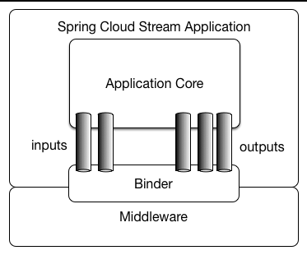
PPT模板下载：www.1ppt.com/moban/ 行业PPT模板：www.1ppt.com/hangye/
节日PPT模板：www.1ppt.com/jieri/ PPT素材下载：www.1ppt.com/sucai/
PPT背景图片：www.1ppt.com/beijing/ PPT图表下载：www.1ppt.com/tubiao/
优秀PPT下载：www.1ppt.com/xiazai/ PPT教程： www.1ppt.com/powerpoint/
Word教程： www.1ppt.com/word/ Excel教程：www.1ppt.com/excel/
资料下载：www.1ppt.com/ziliao/ PPT课件下载：www.1ppt.com/kejian/
范文下载：www.1ppt.com/fanwen/ 试卷下载：www.1ppt.com/shiti/
教案下载：www.1ppt.com/jiaoan/ PPT论坛：www.1ppt.cn

Slide 24

Spring Cloud Sleuth
https://github.com/spring-cloud/spring-cloud-sleuth
日志收集工具包，封装了Dapper和log-based追踪以及Zipkin和HTrace操作，为SpringCloud应用实现了一种分布式追踪解决方案
PPT模板下载：www.1ppt.com/moban/ 行业PPT模板：www.1ppt.com/hangye/
节日PPT模板：www.1ppt.com/jieri/ PPT素材下载：www.1ppt.com/sucai/
PPT背景图片：www.1ppt.com/beijing/ PPT图表下载：www.1ppt.com/tubiao/
优秀PPT下载：www.1ppt.com/xiazai/ PPT教程： www.1ppt.com/powerpoint/
Word教程： www.1ppt.com/word/ Excel教程：www.1ppt.com/excel/
资料下载：www.1ppt.com/ziliao/ PPT课件下载：www.1ppt.com/kejian/
范文下载：www.1ppt.com/fanwen/ 试卷下载：www.1ppt.com/shiti/
教案下载：www.1ppt.com/jiaoan/ PPT论坛：www.1ppt.cn

Slide 25
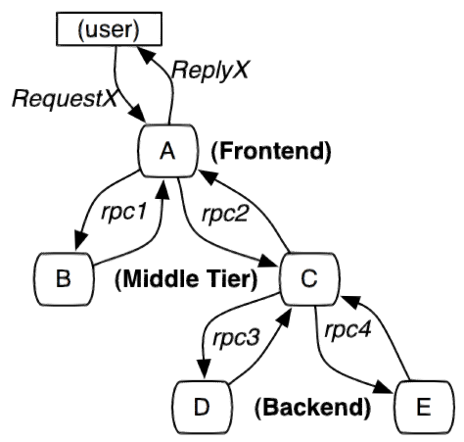
PPT模板下载：www.1ppt.com/moban/ 行业PPT模板：www.1ppt.com/hangye/
节日PPT模板：www.1ppt.com/jieri/ PPT素材下载：www.1ppt.com/sucai/
PPT背景图片：www.1ppt.com/beijing/ PPT图表下载：www.1ppt.com/tubiao/
优秀PPT下载：www.1ppt.com/xiazai/ PPT教程： www.1ppt.com/powerpoint/
Word教程： www.1ppt.com/word/ Excel教程：www.1ppt.com/excel/
资料下载：www.1ppt.com/ziliao/ PPT课件下载：www.1ppt.com/kejian/
范文下载：www.1ppt.com/fanwen/ 试卷下载：www.1ppt.com/shiti/
教案下载：www.1ppt.com/jiaoan/ PPT论坛：www.1ppt.cn

Slide 26
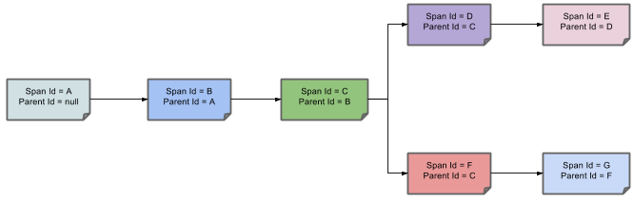
PPT模板下载：www.1ppt.com/moban/ 行业PPT模板：www.1ppt.com/hangye/
节日PPT模板：www.1ppt.com/jieri/ PPT素材下载：www.1ppt.com/sucai/
PPT背景图片：www.1ppt.com/beijing/ PPT图表下载：www.1ppt.com/tubiao/
优秀PPT下载：www.1ppt.com/xiazai/ PPT教程： www.1ppt.com/powerpoint/
Word教程： www.1ppt.com/word/ Excel教程：www.1ppt.com/excel/
资料下载：www.1ppt.com/ziliao/ PPT课件下载：www.1ppt.com/kejian/
范文下载：www.1ppt.com/fanwen/ 试卷下载：www.1ppt.com/shiti/
教案下载：www.1ppt.com/jiaoan/ PPT论坛：www.1ppt.cn

Slide 27
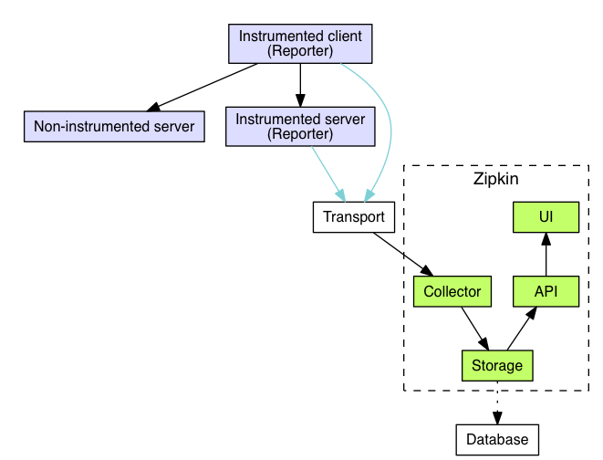
PPT模板下载：www.1ppt.com/moban/ 行业PPT模板：www.1ppt.com/hangye/
节日PPT模板：www.1ppt.com/jieri/ PPT素材下载：www.1ppt.com/sucai/
PPT背景图片：www.1ppt.com/beijing/ PPT图表下载：www.1ppt.com/tubiao/
优秀PPT下载：www.1ppt.com/xiazai/ PPT教程： www.1ppt.com/powerpoint/
Word教程： www.1ppt.com/word/ Excel教程：www.1ppt.com/excel/
资料下载：www.1ppt.com/ziliao/ PPT课件下载：www.1ppt.com/kejian/
范文下载：www.1ppt.com/fanwen/ 试卷下载：www.1ppt.com/shiti/
教案下载：www.1ppt.com/jiaoan/ PPT论坛：www.1ppt.cn

Slide 28
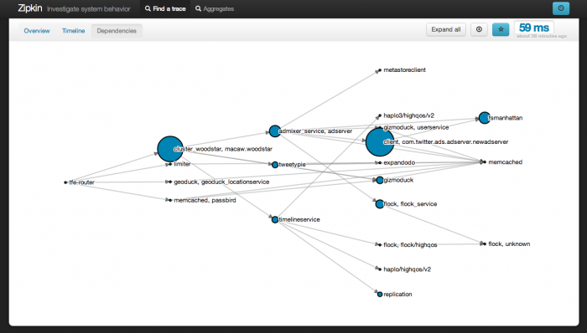
PPT模板下载：www.1ppt.com/moban/ 行业PPT模板：www.1ppt.com/hangye/
节日PPT模板：www.1ppt.com/jieri/ PPT素材下载：www.1ppt.com/sucai/
PPT背景图片：www.1ppt.com/beijing/ PPT图表下载：www.1ppt.com/tubiao/
优秀PPT下载：www.1ppt.com/xiazai/ PPT教程： www.1ppt.com/powerpoint/
Word教程： www.1ppt.com/word/ Excel教程：www.1ppt.com/excel/
资料下载：www.1ppt.com/ziliao/ PPT课件下载：www.1ppt.com/kejian/
范文下载：www.1ppt.com/fanwen/ 试卷下载：www.1ppt.com/shiti/
教案下载：www.1ppt.com/jiaoan/ PPT论坛：www.1ppt.cn

Slide 29
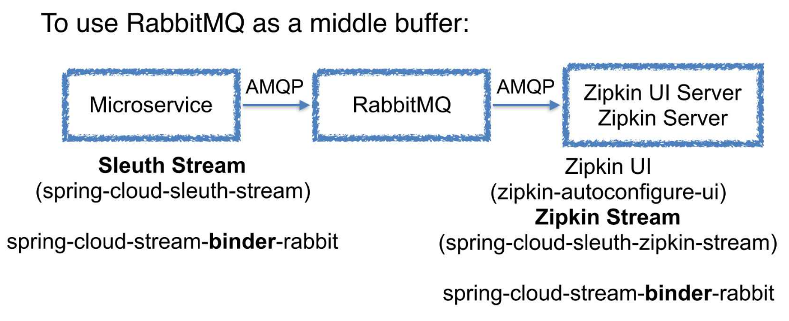
PPT模板下载：www.1ppt.com/moban/ 行业PPT模板：www.1ppt.com/hangye/
节日PPT模板：www.1ppt.com/jieri/ PPT素材下载：www.1ppt.com/sucai/
PPT背景图片：www.1ppt.com/beijing/ PPT图表下载：www.1ppt.com/tubiao/
优秀PPT下载：www.1ppt.com/xiazai/ PPT教程： www.1ppt.com/powerpoint/
Word教程： www.1ppt.com/word/ Excel教程：www.1ppt.com/excel/
资料下载：www.1ppt.com/ziliao/ PPT课件下载：www.1ppt.com/kejian/
范文下载：www.1ppt.com/fanwen/ 试卷下载：www.1ppt.com/shiti/
教案下载：www.1ppt.com/jiaoan/ PPT论坛：www.1ppt.cn

Slide 30

PPT模板下载：www.1ppt.com/moban/ 行业PPT模板：www.1ppt.com/hangye/
节日PPT模板：www.1ppt.com/jieri/ PPT素材下载：www.1ppt.com/sucai/
PPT背景图片：www.1ppt.com/beijing/ PPT图表下载：www.1ppt.com/tubiao/
优秀PPT下载：www.1ppt.com/xiazai/ PPT教程： www.1ppt.com/powerpoint/
Word教程： www.1ppt.com/word/ Excel教程：www.1ppt.com/excel/
资料下载：www.1ppt.com/ziliao/ PPT课件下载：www.1ppt.com/kejian/
范文下载：www.1ppt.com/fanwen/ 试卷下载：www.1ppt.com/shiti/
教案下载：www.1ppt.com/jiaoan/ PPT论坛：www.1ppt.cn

Slide 31

Code Example：
PPT模板下载：www.1ppt.com/moban/ 行业PPT模板：www.1ppt.com/hangye/
节日PPT模板：www.1ppt.com/jieri/ PPT素材下载：www.1ppt.com/sucai/
PPT背景图片：www.1ppt.com/beijing/ PPT图表下载：www.1ppt.com/tubiao/
优秀PPT下载：www.1ppt.com/xiazai/ PPT教程： www.1ppt.com/powerpoint/
Word教程： www.1ppt.com/word/ Excel教程：www.1ppt.com/excel/
资料下载：www.1ppt.com/ziliao/ PPT课件下载：www.1ppt.com/kejian/
范文下载：www.1ppt.com/fanwen/ 试卷下载：www.1ppt.com/shiti/
教案下载：www.1ppt.com/jiaoan/ PPT论坛：www.1ppt.cn

Slide 32

Microservices are not a silver bullet
The microservice architecture is not a silver bullet. It has several drawbacks. Moreover, when using this architecture there are numerous issues that you must address. The microservice architecture pattern language is a collection of patterns for applying the microservice architecture.
The pattern language enables you to decide whether microservices are a good fit for your application.
The pattern language enables you to use the microservice architecture successfully.
PPT模板下载：www.1ppt.com/moban/ 行业PPT模板：www.1ppt.com/hangye/
节日PPT模板：www.1ppt.com/jieri/ PPT素材下载：www.1ppt.com/sucai/
PPT背景图片：www.1ppt.com/beijing/ PPT图表下载：www.1ppt.com/tubiao/
优秀PPT下载：www.1ppt.com/xiazai/ PPT教程： www.1ppt.com/powerpoint/
Word教程： www.1ppt.com/word/ Excel教程：www.1ppt.com/excel/
资料下载：www.1ppt.com/ziliao/ PPT课件下载：www.1ppt.com/kejian/
范文下载：www.1ppt.com/fanwen/ 试卷下载：www.1ppt.com/shiti/
教案下载：www.1ppt.com/jiaoan/ PPT论坛：www.1ppt.cn

Slide 33
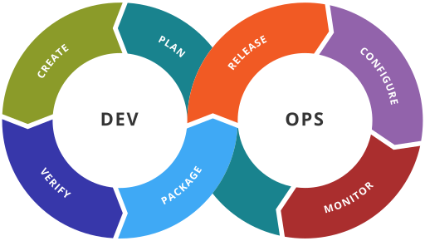
DevOps
PPT模板下载：www.1ppt.com/moban/ 行业PPT模板：www.1ppt.com/hangye/
节日PPT模板：www.1ppt.com/jieri/ PPT素材下载：www.1ppt.com/sucai/
PPT背景图片：www.1ppt.com/beijing/ PPT图表下载：www.1ppt.com/tubiao/
优秀PPT下载：www.1ppt.com/xiazai/ PPT教程： www.1ppt.com/powerpoint/
Word教程： www.1ppt.com/word/ Excel教程：www.1ppt.com/excel/
资料下载：www.1ppt.com/ziliao/ PPT课件下载：www.1ppt.com/kejian/
范文下载：www.1ppt.com/fanwen/ 试卷下载：www.1ppt.com/shiti/
教案下载：www.1ppt.com/jiaoan/ PPT论坛：www.1ppt.cn

Slide 34
DevOps toolchain
Code — code development and review, source code management tools, code merging
Build — continuous integration tools, build status
Test — continuous testing tools that provide feedback on business risks
Package — artifact repository, application pre-deployment staging
Release — change management, release approvals, release automation
Configure — infrastructure configuration and management, Infrastructure as Code tools
Monitor — applications performance monitoring, end–user experience
PPT模板下载：www.1ppt.com/moban/ 行业PPT模板：www.1ppt.com/hangye/
节日PPT模板：www.1ppt.com/jieri/ PPT素材下载：www.1ppt.com/sucai/
PPT背景图片：www.1ppt.com/beijing/ PPT图表下载：www.1ppt.com/tubiao/
优秀PPT下载：www.1ppt.com/xiazai/ PPT教程： www.1ppt.com/powerpoint/
Word教程： www.1ppt.com/word/ Excel教程：www.1ppt.com/excel/
资料下载：www.1ppt.com/ziliao/ PPT课件下载：www.1ppt.com/kejian/
范文下载：www.1ppt.com/fanwen/ 试卷下载：www.1ppt.com/shiti/
教案下载：www.1ppt.com/jiaoan/ PPT论坛：www.1ppt.cn

Slide 35



DevOps Tools
PPT模板下载：www.1ppt.com/moban/ 行业PPT模板：www.1ppt.com/hangye/
节日PPT模板：www.1ppt.com/jieri/ PPT素材下载：www.1ppt.com/sucai/
PPT背景图片：www.1ppt.com/beijing/ PPT图表下载：www.1ppt.com/tubiao/
优秀PPT下载：www.1ppt.com/xiazai/ PPT教程： www.1ppt.com/powerpoint/
Word教程： www.1ppt.com/word/ Excel教程：www.1ppt.com/excel/
资料下载：www.1ppt.com/ziliao/ PPT课件下载：www.1ppt.com/kejian/
范文下载：www.1ppt.com/fanwen/ 试卷下载：www.1ppt.com/shiti/
教案下载：www.1ppt.com/jiaoan/ PPT论坛：www.1ppt.cn

Slide 36

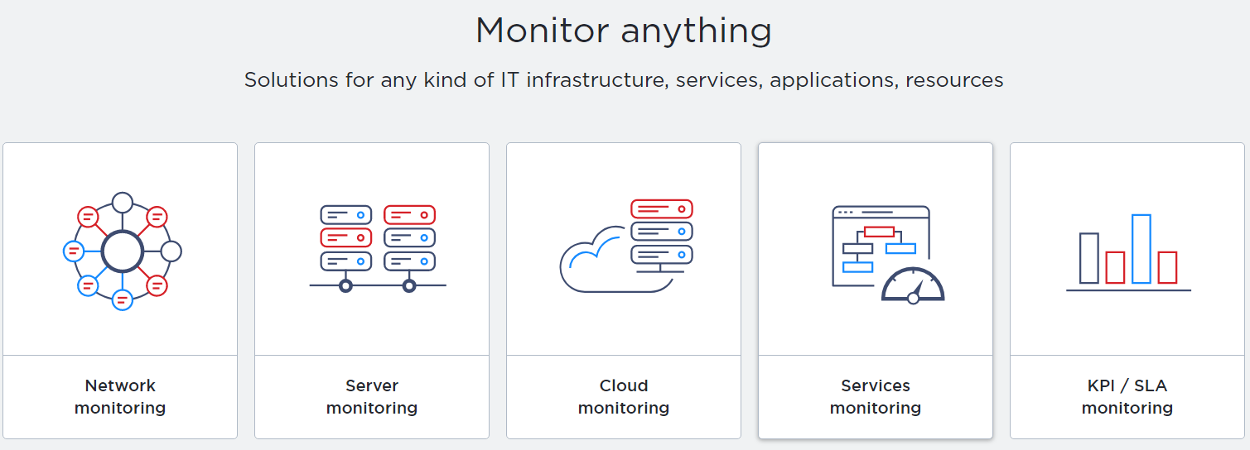
Monitor Tools
PPT模板下载：www.1ppt.com/moban/ 行业PPT模板：www.1ppt.com/hangye/
节日PPT模板：www.1ppt.com/jieri/ PPT素材下载：www.1ppt.com/sucai/
PPT背景图片：www.1ppt.com/beijing/ PPT图表下载：www.1ppt.com/tubiao/
优秀PPT下载：www.1ppt.com/xiazai/ PPT教程： www.1ppt.com/powerpoint/
Word教程： www.1ppt.com/word/ Excel教程：www.1ppt.com/excel/
资料下载：www.1ppt.com/ziliao/ PPT课件下载：www.1ppt.com/kejian/
范文下载：www.1ppt.com/fanwen/ 试卷下载：www.1ppt.com/shiti/
教案下载：www.1ppt.com/jiaoan/ PPT论坛：www.1ppt.cn

Slide 37

推荐学习网址 - Spring Cloud
http://projects.spring.io/spring-cloud/
https://github.com/spring-cloud
PPT模板下载：www.1ppt.com/moban/ 行业PPT模板：www.1ppt.com/hangye/
节日PPT模板：www.1ppt.com/jieri/ PPT素材下载：www.1ppt.com/sucai/
PPT背景图片：www.1ppt.com/beijing/ PPT图表下载：www.1ppt.com/tubiao/
优秀PPT下载：www.1ppt.com/xiazai/ PPT教程： www.1ppt.com/powerpoint/
Word教程： www.1ppt.com/word/ Excel教程：www.1ppt.com/excel/
资料下载：www.1ppt.com/ziliao/ PPT课件下载：www.1ppt.com/kejian/
范文下载：www.1ppt.com/fanwen/ 试卷下载：www.1ppt.com/shiti/
教案下载：www.1ppt.com/jiaoan/ PPT论坛：www.1ppt.cn

Slide 38

PPT模板下载：www.1ppt.com/moban/ 行业PPT模板：www.1ppt.com/hangye/
节日PPT模板：www.1ppt.com/jieri/ PPT素材下载：www.1ppt.com/sucai/
PPT背景图片：www.1ppt.com/beijing/ PPT图表下载：www.1ppt.com/tubiao/
优秀PPT下载：www.1ppt.com/xiazai/ PPT教程： www.1ppt.com/powerpoint/
Word教程： www.1ppt.com/word/ Excel教程：www.1ppt.com/excel/
资料下载：www.1ppt.com/ziliao/ PPT课件下载：www.1ppt.com/kejian/
范文下载：www.1ppt.com/fanwen/ 试卷下载：www.1ppt.com/shiti/
教案下载：www.1ppt.com/jiaoan/ PPT论坛：www.1ppt.cn

Slide 39

PPT模板下载：www.1ppt.com/moban/ 行业PPT模板：www.1ppt.com/hangye/
节日PPT模板：www.1ppt.com/jieri/ PPT素材下载：www.1ppt.com/sucai/
PPT背景图片：www.1ppt.com/beijing/ PPT图表下载：www.1ppt.com/tubiao/
优秀PPT下载：www.1ppt.com/xiazai/ PPT教程： www.1ppt.com/powerpoint/
Word教程： www.1ppt.com/word/ Excel教程：www.1ppt.com/excel/
资料下载：www.1ppt.com/ziliao/ PPT课件下载：www.1ppt.com/kejian/
范文下载：www.1ppt.com/fanwen/ 试卷下载：www.1ppt.com/shiti/
教案下载：www.1ppt.com/jiaoan/ PPT论坛：www.1ppt.cn

